Slide 1

HILBERT R-TREE
IMPLEMENTATION
GROUP-12

Slide 2





ANTI-PLAGIARISM STATEMENT
We certify that this assignment is our own work, based on our personal study and/or research and that. We have acknowledged all material and sources used in its preparation, whether they be books, articles, reports, lecture notes, and any other kind of document, electronic or personal communication. We also certify that this assignment has not previously been submitted for assessment in any other unit, except where specific permission has been granted from all unit coordinators involved, or at any other time in this unit, and that we have not copied in part or whole or otherwise plagiarised the work of other students and/or persons.
Deepak Kalra
Aryan Bakshi
Harpreet Singh Anand
Yash Pandey
Mihika Deshpande

Slide 3
Concept and Need for R-Trees
The existence of Spatial Data Objects necessitates the use of multi-dimensional indexing structures to traverse the database.
Guttman proposed R-trees(rectangle trees) as a data structure to represent data objects in several dimensions (this particular paper deals with 2 dimensional representation only).
R-trees are designed to efficiently store and retrieve spatial data, such as points, lines, and polygons, by partitioning space into a hierarchy of nested rectangles.Their structure is optimized to minimize the number of disk accesses required to perform spatial queries, such as range and nearest-neighbor searches.
Use cases:
CAD software
GIS: Maps storing geographical locations in the form of polygons which can then be queried to provide results as per user requirements

Slide 4
Basic Structure of R-trees
It is a height balanced tree similar to B-trees i.e all leaf nodes are at the same depth
The leaf nodes contain pointers to data objects
Nearby objects are represented by their minimum bounding rectangle at the next level of the tree.
A Minimal Bounding Rectangle is used to represent a more complicated structure. It is a rectangle which minimally encloses the more complex shape.
The "R" in R-tree refers to rectangle, as these rectangles are used to contain all the objects within a given region of space. Since all objects are enclosed by the bounding rectangle, a query that does not intersect the rectangle also cannot intersect any of the objects it contains.
At the leaf level of the tree, each rectangle represents a single object, while at higher levels, the rectangles represent a higher number of objects.
The larger the group of objects being clubbed together, the less precise will be the approximation of the data.

Slide 5
Problems
Some problems arise from the realisation of an R-Tree. Specially searching and inserting show some negative effects:
1. Searching
An unfavourable index record can be overlapped by other regions, however, it’s saved in just one region. For instance, in the search for a point data entry. The search algorithm would check some subtrees in vain. The more dimension there are, the more overlaps exists and the more checks are done in vain. Thus the R-Tree has an efficiency problem if there is an exact search. However, an exact search is especially necessary for deletion and insertion.
2. Inserting
Sometimes a region has to enlarge in order to include a new rectangle. This can be propagated upward. Because of that, the risk of overlaps arise again.When handling with small and favourable records, these problems are not very significant. However, if there are a lot of unfavourable and multi-dimensional records the efficiency is quite impaired.

Slide 6
R-trees and Variations
R +-Tree [Sell87]
This tree tries to minimize the overlapping of regions. Here, objects are saved disjunctive. The search algorithm is faster but the tree structure is more complicated.
R*-Tree [Beck90]
The SplitNode algorithm takes volume and the extend of overlapping into consideration. All other properties are similar to the R-Tree.
X-Tree [Berc96]
It includes a Split − History and a function for node enlargement. This prevents overlapping of regions.

Slide 7
Hilbert R-trees: A Special Variation
The performance of the R-trees depends on the performance and efficiency of the algorithms that cluster the data rectangles to a node. We use space filling curves (or fractals), and specifically, the Hilbert curve to impose a linear ordering on the data rectangles
The Hilbert Curve gives a mapping between 1D and 2D space in such a way that two points that are close in one space will remain so after transformation as well.

Slide 8
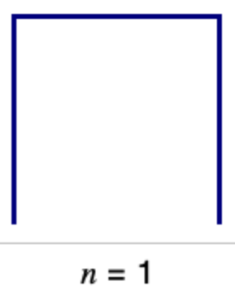

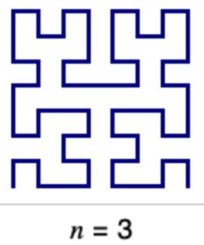
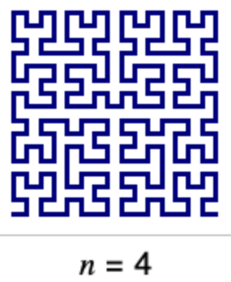
Order of a Hilbert R-tree
The order of a Hilbert curve refers to the level of recursion or the number of times the basic construction rule of the curve is applied. It is a measure of the complexity and size of the curve.
The order of a Hilbert curve is typically denoted by an integer "n", where n >= 1. At the first level of recursion, n=1, the Hilbert curve is a simple line segment. At the second level of recursion, n=2, the curve consists of four line segments forming a square. At each subsequent level of recursion, the curve is constructed by recursively dividing each square into four smaller squares, and connecting them in a specific pattern to form a continuous curve.
Thus, the total number of line segments in a Hilbert curve of order n can be calculated as 2^(2n) - 1. Similarly, the total number of points in the curve is (2^(2n+1)) - 1.

Slide 9
H-value and MBR in Hilbert R-trees
The H-value of a rectangle refers to the H-value of its center.The "h" value of a Hilbert R-tree refers to the number of bits used to encode each dimension in the Hilbert curve that is used to construct the R-tree.
MBR refers to the minimum Bounding Rectangle:
an expression of the maximum extents of a two-dimensional object (e.g. point, line, polygon) or set of objects within its x-y coordinate system; in other words min(x), max(x), min(y), max(y)

Slide 10
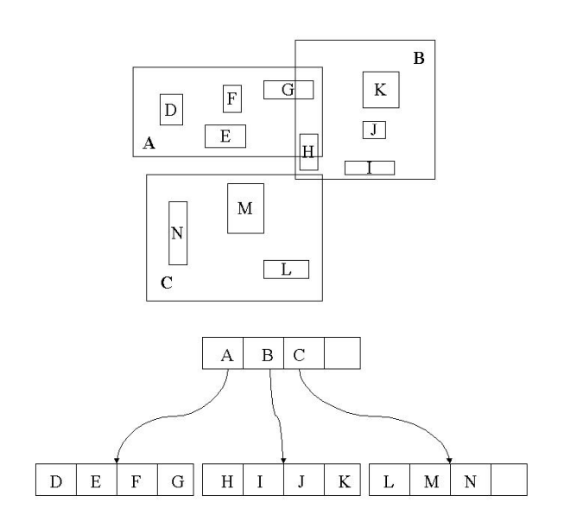

Slide 11
Structure of Hilbert R-trees
The two basic tenets:
- It can behave like an R-tree on search
- It can support deferred splitting on insertion, using the Hilbert value of the inserted rectangle
Every node of the tree stores its MBR and Largest H-Value(LHV) of the data rectangles that belong to the subtree of root n
A non-leaf node in the Hilbert R-tree contains at most Cn entries of the form (R, ptr, LHV)

Slide 12
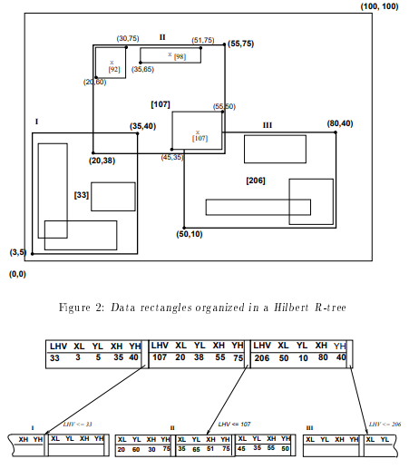

Slide 13
Structures Implemented
Point:- It is used to store a point. It has 2 members x and y. Which store their respective coordinates.
Rectangle:- It is used to represent a rectangle which stores the bottom left and the top right points. It also stores the hilbert value of the center of the rectangle. Its members are bottom_left, top_right and h.
LeafEntry:- It stores the minimum bounding rectangle for its children node and the object id of entry
LeafNode:- One leafNode stores the number of leaf entries and an array of LeafEntry
NonLeafEntry:- It stores the minimum bounding rectangle, bounding its child node and the LHV of the entries in the child node
LeafNode:- It stores the number of entries in that node. It also has an array which stores all the rectangles in it. Its members are num_enterie and entries[MAX_CHILDREN]
Node:- Firstly it contains a member is_leaf which stores value 0 and 1. Then it has a parent_ptr which point to the parent_node of that node. It also contains a union of LeafNode and a NonLeafNode.
HilbertTree:- In this we are storing the height of our tree and the root node.

Slide 14
Algorithms Implemented
Insert
ChooseLeaf
AdjustTree
InsertNode
HandleOverflow
HandleOverFlowNode
Search

Slide 15
Insert(NODE Root, Rectangle r)
Purpose: Inserts a new rectangle r in the Hilbert R-tree. To insert a new rectangle r in the Hilbert R-tree, the Hilbert value h of the center of the new rectangle is used as a key. In each level we choose the node with minimum LHV among the siblings. When a leaf node is reached the rectangle r is inserted in its correct order according to h. After a new rectangle is inserted in a leaf node N, AdjustTree is called to x the MBR and LHV values in upper level node
It invokes three algorithms: ChooseLeaf, HandleOverflow and AdjustTree
Working:
I1. Find the appropriate leaf node: Invoke ChooseLeaf(r, h) to select a leaf node L in which to place r.
I2. Insert r in a leaf node L: if L has an empty slot, insert r in L in the appropriate place according to the Hilbert order and return. if L is full, invoke HandleOverflow(L,r), which will return new leaf if split was inevitable.
I3. Propagate changes upward: form a set S that contains L, its cooperating siblings and the new leaf (if any). invoke AdjustTree(S)
I4. Grow tree taller: if node split propagation caused the root to split, create a new root whose children are the two resulting nodes.

Slide 16
ChooseLeaf(NODE root,Rectangle r,int h)
Purpose: Returns the leaf node in which new rectangle r should be placed given current state of the tree
Takes the root node, rectangle and it’s hilbert value as input, if the root is a leaf; it is the only node present; returns it. Otherwise finds the entry with minimum LHV greater than h (or with maximum LHV, if all less than h). Returns the leaf node as base case
Working:
N is set to be the root node
If N is a leaf, N is returned
If N is a non-leaf node, choose the entry (R, ptr, LHV) with the minimum LHV value greater than h
Set N to the node pointed by ptr and repeat above step

Slide 17
AdjustTree(NODE LeafNode, NODE newLeafNode, set S, int s_size)
Purpose: S is a set of nodes that contains the node being updated, its cooperating siblings (if over ow has occurred) and newly created node NN (if split has occurred). The routine ascends from leaf level towards the root, adjusting MBR and LHV of nodes that cover the nodes in S. siblings. It propagates splits (if any)
Working:
A1. if reached root level stop.
A2. Propagate node split upward let Np be the parent node of N. if N has been split, let NN be the new node. insert NN in Np in the correct order according to its Hilbert value if there is room. Otherwise, invoke HandleOverflow(Np, NN). if Np is split, let PP be the new node.
A3. adjust the MBR's and LHV's in the parent level: let P be the set of parent nodes for the nodes in S. Adjust the corresponding MBR's and LHV's appropriately of the nodes in P.
A4. Move up to next level: Let S become the set of parent nodes P, with NN = PP, if Np was split. repeat from A1.

Slide 18
InsertNode(Np, NN)
Purpose: Called in the adjustTree function to insert NN as a new non-leaf entry into Np.
Finds the index of entry where NN should be inserted
Shifts entries forward to clear index
Adds a new non leaf entry at the index

Slide 19
HandleOverflow(NODE N, Rectangle r)
The overflow handling algorithm in the Hilbert R-tree implements the 2-3 split policy of Hilbert RTree, it creates a set of all entries in the node and its siblings and either evenly distributes them amongst all, if atleast one is not full or creates a new node and evenly distributes the entry, if all siblings were full.
Problem: return the new node if a split occurred.
H1. let E be a set that contains all the entries from N and its s 1 cooperating siblings.
H2. add r to E.
H3. if at least one of the s 1 cooperating siblings is not full, distribute E evenly among the s nodes according to the Hilbert value.
H4. if all the s cooperating siblings are full, create a new node NN and distribute E evenly among the s + 1 nodes according to the Hilbert value. return

Slide 20
HandleOverflowNode(NODE Np, NODE NN)
This function is called when the parent node already has maximum number of non leaf entries and cannot accommodate the new node created on splitting. We create a set of all nonleaf entries in Np and its sibling nodes, if all siblings are full as well; we create a new node (new_node) and evenly distribute the entries.
H1. let E be a set that contains all the non-leaf entries from Np and its 1 cooperating siblings.
H2. Add NN as the child pointer of a new non-leaf entry to E
H3. if at least one of the 1 cooperating siblings is not full, distribute E evenly among the nodes according to the Largest Hilbert value of non leaf entries.
H4. if all the cooperating siblings are full, create a new node new_node and distribute E evenly among the nodes according to the Largest Hilbert value

Slide 21
Search(NODE Root, Rectangle w)
Purpose: In searching algorithm we start from the root the tree and and find all the rectangles which intersect the query rectangles.
Working:-
We are searching for all the non leaf nodes whose minimum bounding rectangle intersects with the query window.
Then we are going down the tree to search all the leaf nodes which are the children(or grandchildren or may be at a much lower relationship) of the earlier selected nodes.
For checking if 2 rectangles intersect we have made an intersect function which takes 2 rectangles as input. Then in search function we are going down the root and check if the mbr intersects with the given rectangle but as soon as a leaf is detected and the search results would we displayed in an array which it would return

Slide 22
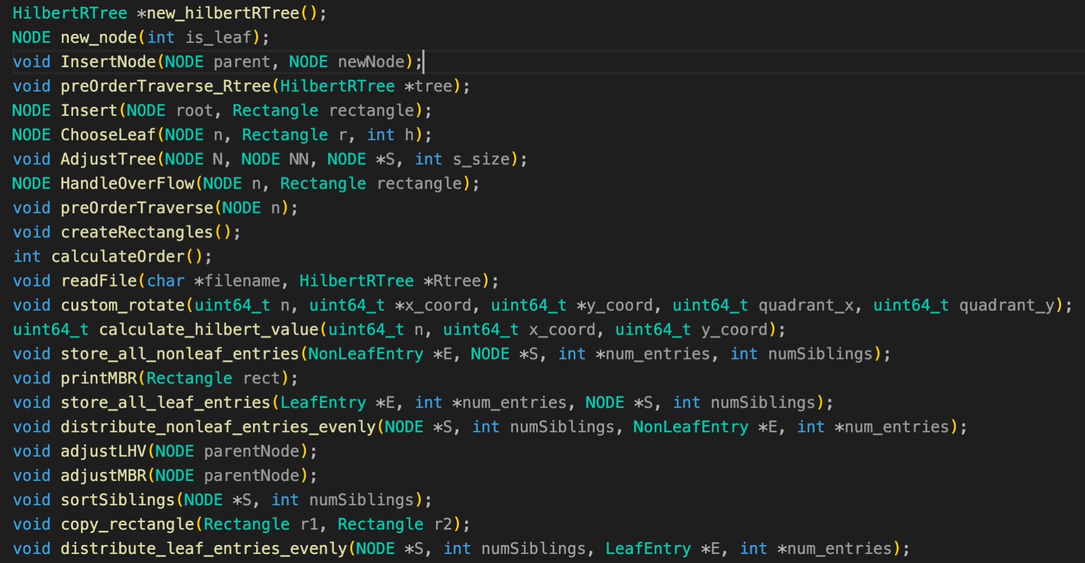
Function Declaration

Slide 23
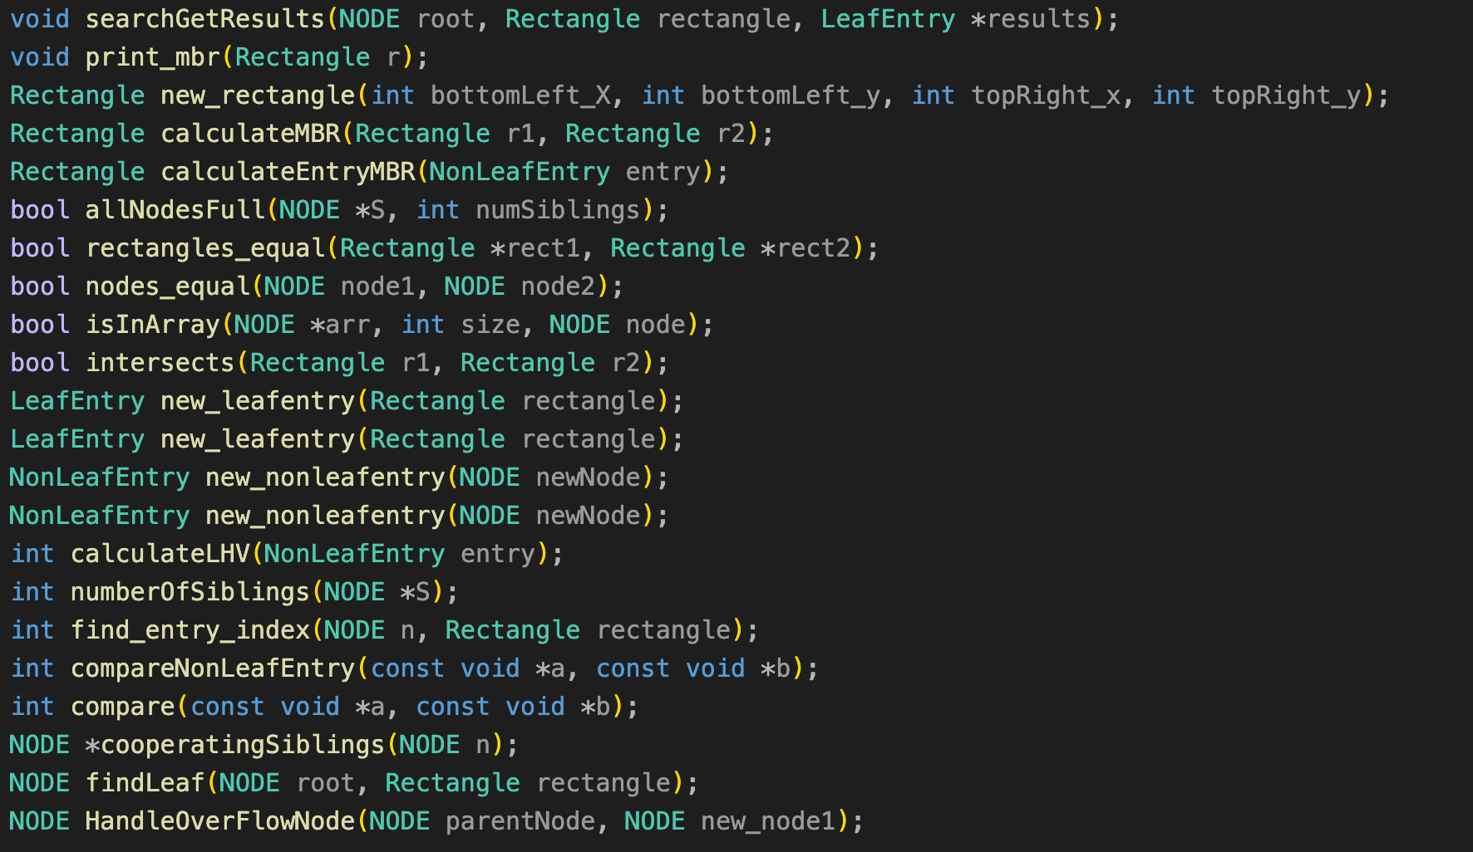
Function Declarations

Slide 24
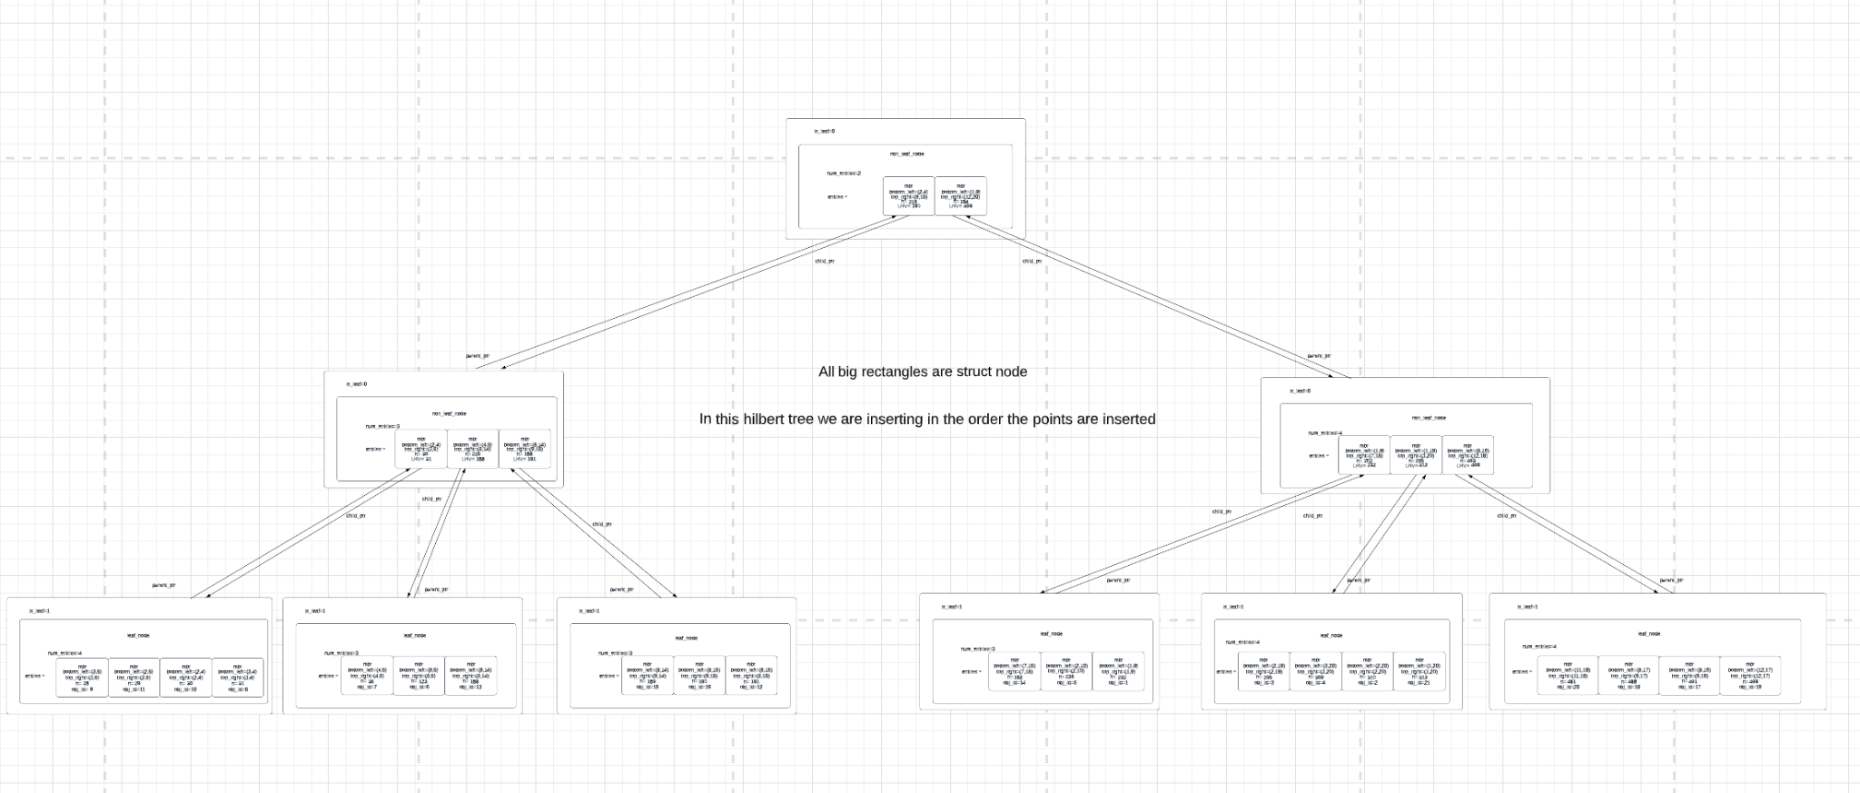
Representation of Hilbert R Tree
After running our code on data.txt having 21 entries.
Since the screenshot is not clear you can check it on: Hilbert R-tree

Slide 25
Conclusion
The paper presents a novel variant of the R-tree, which surpasses all previous R-tree techniques. The main concept involves creating a "good" arrangement among rectangles, resulting in better packing, shallower trees, higher fanouts, and faster response times. By grouping similar rectangles together, the R-tree has nodes with smaller MBRs. The Hilbert R-tree, a dynamic tree structure capable of managing insertions and deletions, was developed based on this idea. Future work could concentrate on analyzing Hilbert R-trees to provide analytical formulas that predict response times based on data rectangle characteristics, such as count and data density.

Slide 26
References
I. Kamel and C.Faloutsos. Hilbert R-Tree: An improved R-tree using fractals.
R-Trees - A Dynamic Index Structure for Spatial Searching
3. Hilbert R-tree - Wikipedia
4. Hilbert curve - Wikipedia

Slide 27
Group Members
Yash Pandey 2021A7PS0661P
Deepak Kalra 2021A7PS2214P
Harpreet Singh Anand 2021A7PS2416P
Mihika Deshpande 2021A7PS2435P
Aryan Bakshi 2021A7PS0532P

